Slide 1

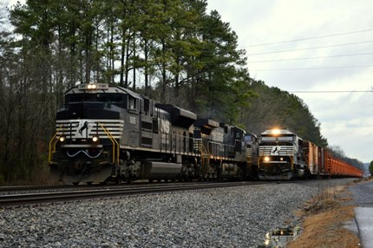
Major Project Documentation
“RAILWAY RESERVATION SYSTEM”
Bachelors of Computer Application
Year 2018-2019
SUBMITTED TO SUBMITTED BY Mr. Ashutosh Srivastava Shubham Kumar Prajapati
BCA - 1817407104

